Slide 1
ENCOUNTERS WITH JESUS
Stories of Jesus’ interaction with people in John and what that means for us now

Slide 2
ENCOUNTERS WITH JESUS
The Chosen
Download the App
Stories of Jesus’ interaction with people in John and what that means for us now

Slide 3
Thomas – What are you thinking?
Jesus encounters Thomas
JOHN 20:19-29

Slide 4
Thomas – What are you thinking?
Matthew 10:3 : Called by Jesus to be a disciple
CONTENT GOES HERE
JOHN 20

Slide 5
Thomas – What are you thinking?
Matthew 10:3 : Called by Jesus to be a disciple
John 11:16 : Then Thomas (called Didymus) said to the rest of the disciples, “Let us also go, that we may die with him.”
CONTENT GOES HERE
JOHN 20

Slide 6
Thomas – What are you thinking?
Matthew 10:3 : Called by Jesus to be a disciple
John 11:16 : Then Thomas (called Didymus) said to the rest of the disciples, “Let us also go, that we may die with him.”
John 13-17 : ^{14:5}Thomas said to him, “Lord, we don’t know where you are going, so how can we know the way?”
CONTENT GOES HERE
JOHN 20

Slide 7
Thomas – What are you thinking?
Jesus Appears to His Disciples
¹⁹On the evening of that first day of the week, when the disciples were together, with the doors locked for fear of the Jews, Jesus came and stood among them and said, “Peace be with you!” ²⁰After he said this, he showed them his hands and side. The disciples were overjoyed when they saw the Lord.
²¹Again Jesus said, “Peace be with you! As the Father has sent me, I am sending you.” ²²And with that he breathed on them and said, “Receive the Holy Spirit. ²³If you forgive anyone his sins, they are forgiven; if you do not forgive them, they are not forgiven.”
CONTENT GOES HERE
JOHN 20

Slide 8
Thomas – What are you thinking?
²⁵So the other disciples told him, “We have seen the Lord!”
But he said to them, “Unless I see the nail marks in his hands and put my finger where the nails were, and put my hand into his side, I will not believe it.” A
CONTENT GOES HERE
^{20:25}So the other disciples told him, “We have seen the Lord!” But he said to them, “Unless I see the nail marks in his hands and put my finger where the nails were, and put my hand into his side, I will not believe it.”
JOHN 20

Slide 9
Thomas – What are you thinking?
²⁵So the other disciples told him, “We have seen the Lord!”
But he said to them, “Unless I see the nail marks in his hands and put my finger where the nails were, and put my hand into his side, I will not believe it.” A
What is doubt?
CONTENT GOES HERE
JOHN 20

Slide 10
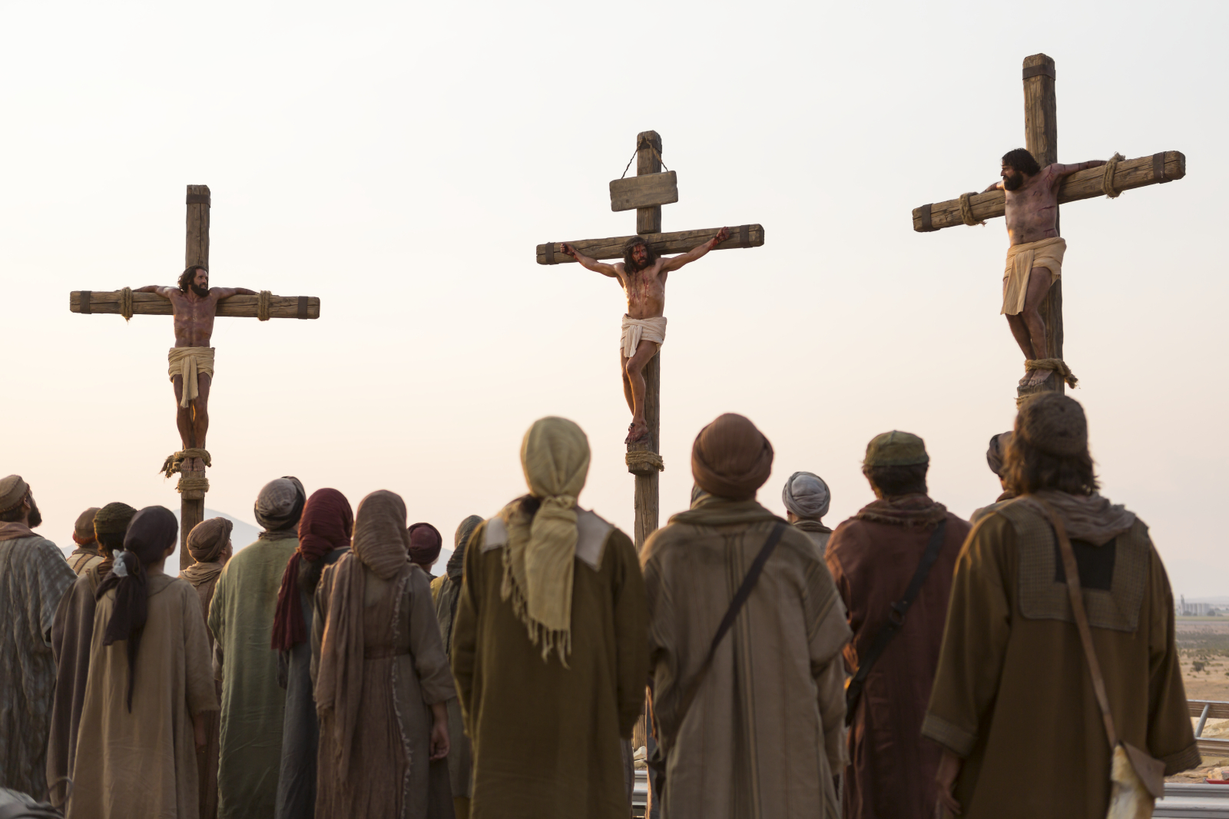
Thomas – What are you thinking?
JOHN 20

Slide 11
Thomas – What are you thinking?
^{20:26} A week later his disciples were in the house again, and Thomas was with them. Though the doors were locked, Jesus came and stood among them and said, “Peace be with you!” ²⁷Then he said to Thomas, “Put your finger here; see my hands. Reach out your hand and put it into my side. Stop doubting and believe.”
²⁸Thomas said to him, “My Lord and my God!”
²⁹Then Jesus told him, “Because you have seen me, you have believed; blessed are those who have not seen and yet have believed.” John 20
JOHN 20

Slide 12
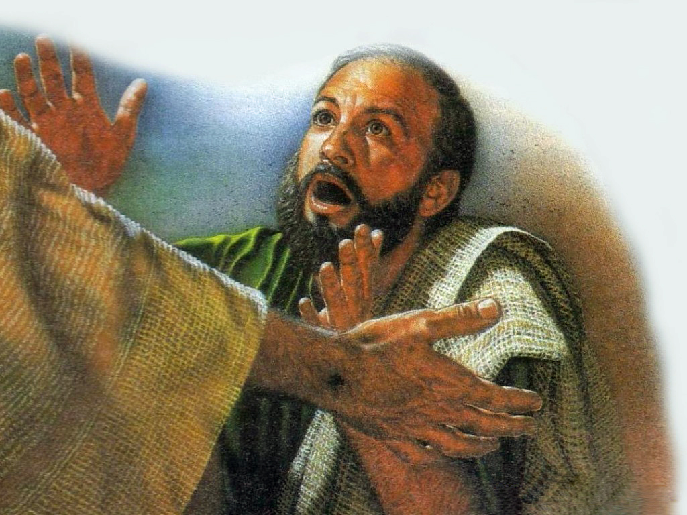
Thomas – What are you thinking?
JOHN 20

Slide 13
Thomas – What are you thinking?
John 21: Thomas out fishing with 6 other disciples
Jesus speaks to them – they know who he is
Acts 1: Thomas saw Jesus return to heaven
4th Century documents reveal Thomas went to India shared his faith
JOHN 20

Slide 14
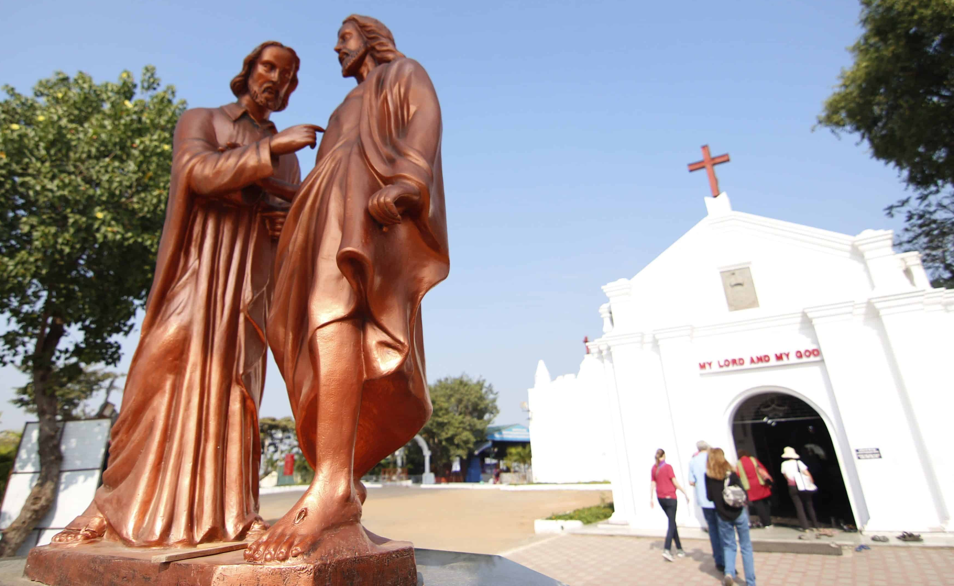
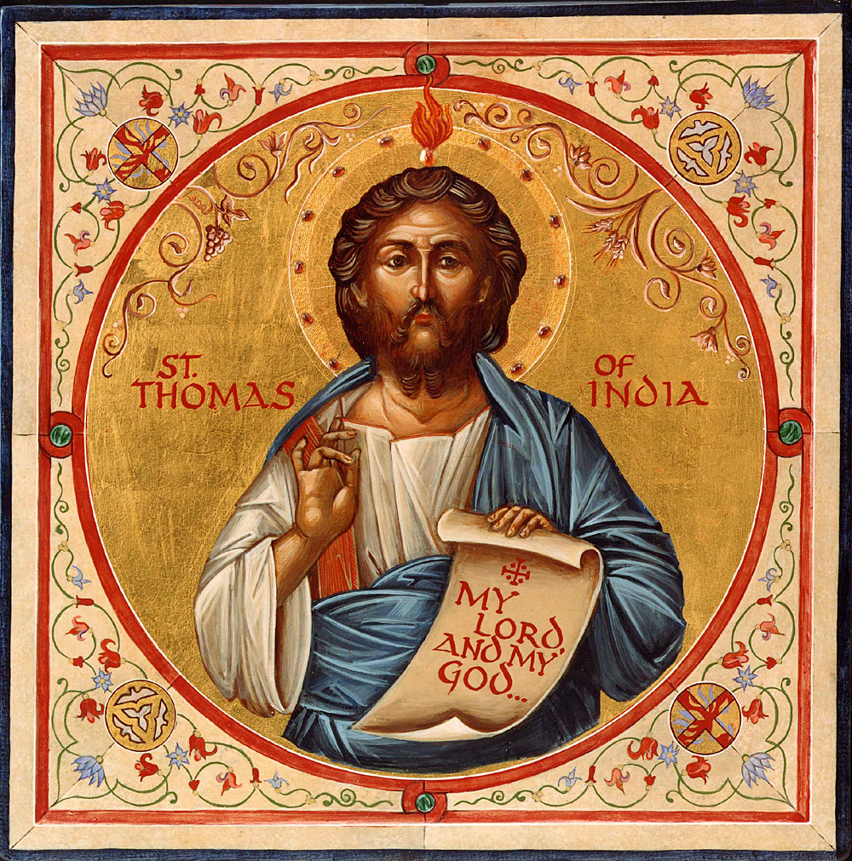

Slide 15
Thomas – What are you thinking?
JOHN 20

